Slide 1
Putting REALTOR® Safety First:
Safety Strategies for the
Modern REALTOR®

Slide 2

NAR’s Safety Program
Reduce the number of safety incidents that occur in the industry
Every REALTOR® comes home safely to their family every night
www.nar.realtor/safety

Slide 3


Slide 4
Module 1:
Your Personal Safety

Slide 5
Safety Spheres
Your personal safety
Your office and colleagues
Buyers
Sellers
Online
Your home and family
What happens in one safety sphere can impact others

Slide 6
Five Key Actions
Strategy
Best practices
Learn from webinars and videos
Learn and use personal protection resources
Improve safety culture

Slide 7
A High-Risk Business?
87 real estate professionals met with fatal injuries in 2019 per U.S. Bureau of Labor Statistics
One-third caused by “violence and other injuries”
Many incidents are never reported
When one real estate professional is harmed, all suffer

Slide 8
Why Is Real Estate Risky?
Image of success
Meeting unknown prospects at properties
Working at unfamiliar properties at odd hours
Sitting open houses alone
Entering vacant properties
Driving with strangers while multitasking
Public visibility
Many ways for prospects to make contact
Handling client’s personal information
Who would harm me?

Slide 9
What Do Others Say?
Have been the victim of a crime while on the job
Felt threatened on the job










Slide 10
What Do Others Say?
Feared for personal safety or
safety of personal information
When and Where
35% After a threatening email, text message, phone call, or voicemail
17% During an open house
7% Meeting a new client for the first time at a secluded location/property
7% Driving a client
7% During a showing
3% Meeting a new client for the first time in a public place

Slide 11
What Do Others Say?
Meets unknown prospects at the real estate office or a neutral location first
More women than men have
feared for their safety

Slide 12
What Do Others Say?
58% Use a smartphone app to track whereabouts
49% Carry a self-defense weapon
38% Have taken a self-defense course
29% Participated in a REALTOR® safety course
The most common types of
self-defense weapons
 | Women |  | Men
Pepper spray |  | 26% | 5%
Firearm |  | 11% | 21%
Pocket knife |  | 5% | 11%
Taser |  | 6% | 1%
Baton/club |  | 4% | 6%
Battery operated noisemaker |  | 2% | 3%

Slide 13
What Do Others Say?
Real estate brokerage has standard procedures for agent safety
Real estate office has standard procedures for safeguarding and proper disposal of client data

Slide 14
The Crime Equation
Motive
+ Opportunity
= Crime
Remove part of the equation, lessen likelihood of a crime

Slide 15
Understanding the Criminal Mind and Motivation
 | Predator | Thief
Motive | Power, control | Profit
Crime | Assault, rape, murder | Burglary, robbery
Emotional | Yes | No
Goal | Isolate the victim | Be isolated
Decision-making | Fulfill emotional needs | Potential profit versus risk

Slide 16

Sharpen Your Safety Sense
All of us have a built-in safety sense, our survival instinct
What does instinct feel like?
Nagging feeling Wonder—What if? Anxiety Hunches Gut feeling Curiosity | Doubt Hesitation Suspicion Apprehension Fear Dark humor

Slide 17
10-Second Safety Scan
Take 2 seconds when you
  Arrive at your destination
  Step out of your car
  Walk toward the property
  Arrive at the door
  Enter the property
Remember POWDER
Parking your car
Out of your car
Walking to the property
Door
Entering the property
Reverse the scan steps when leaving

Slide 18
How We Respond to Threats
Denial and delay:
This can’t be happening!
Deliberation:
What should I do?
Decision:
Okay. Here goes!
Recycle through denial, delay, deliberation.
Physical responses:
  Stress hormones
  Heart rate increases
  Dissociation
  Shutting down: negative panic
What can we do?
  Confidence
  Preparation

Slide 19
The Strongest Defense
“The strongest defense is a plan of what you will do to avoid high-risk situations and what you will do if you find yourself in danger.”
Amanda Ripley, The Unthinkable, Who Survives When Disaster Strikes—and Why.

Slide 20
Fight or Flight?
Depends on a combination of factors:
Physical capability
Proximity of the attacker
Presence of a weapon
Knowledge of self-defense

Slide 21
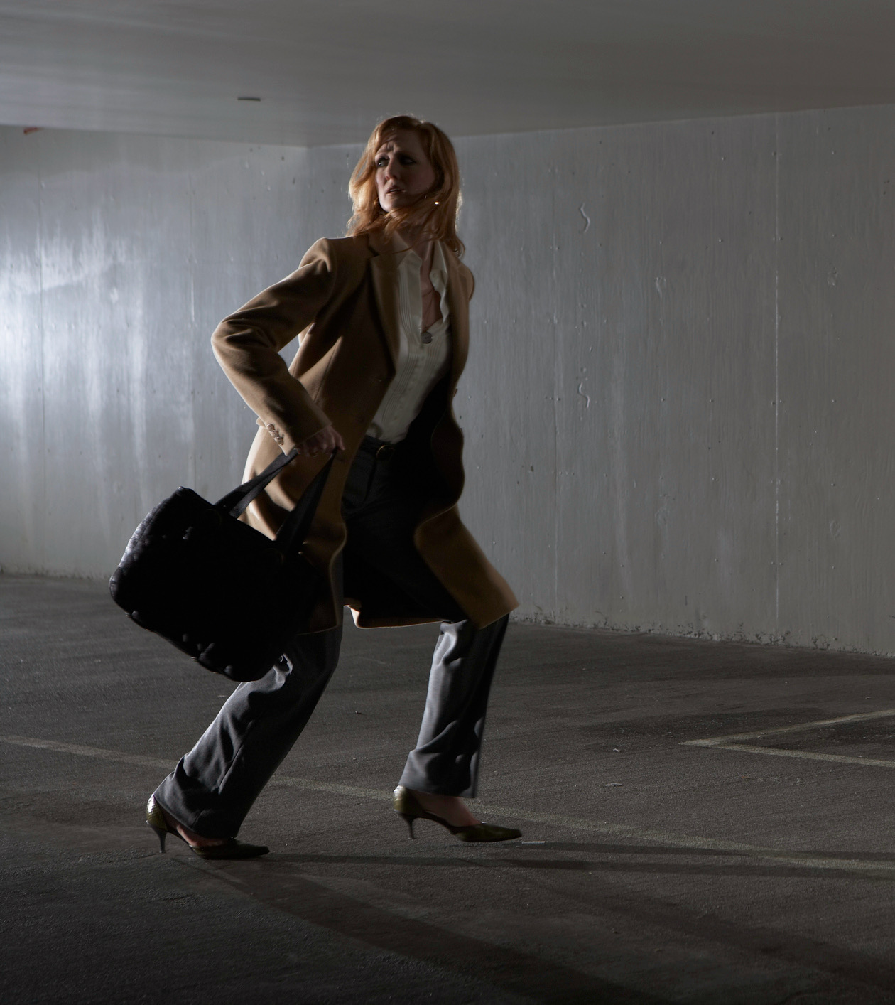
Escape the Situation
If threatened––act decisively and escape unharmed
Don’t apologize or announce intention
Running away is as courageous as fighting back
Can you make an escape?

Slide 22
Can You Escape?
Fitness level and stamina
Clothing
Terrain and obstacles
Safe location to run to

Slide 23
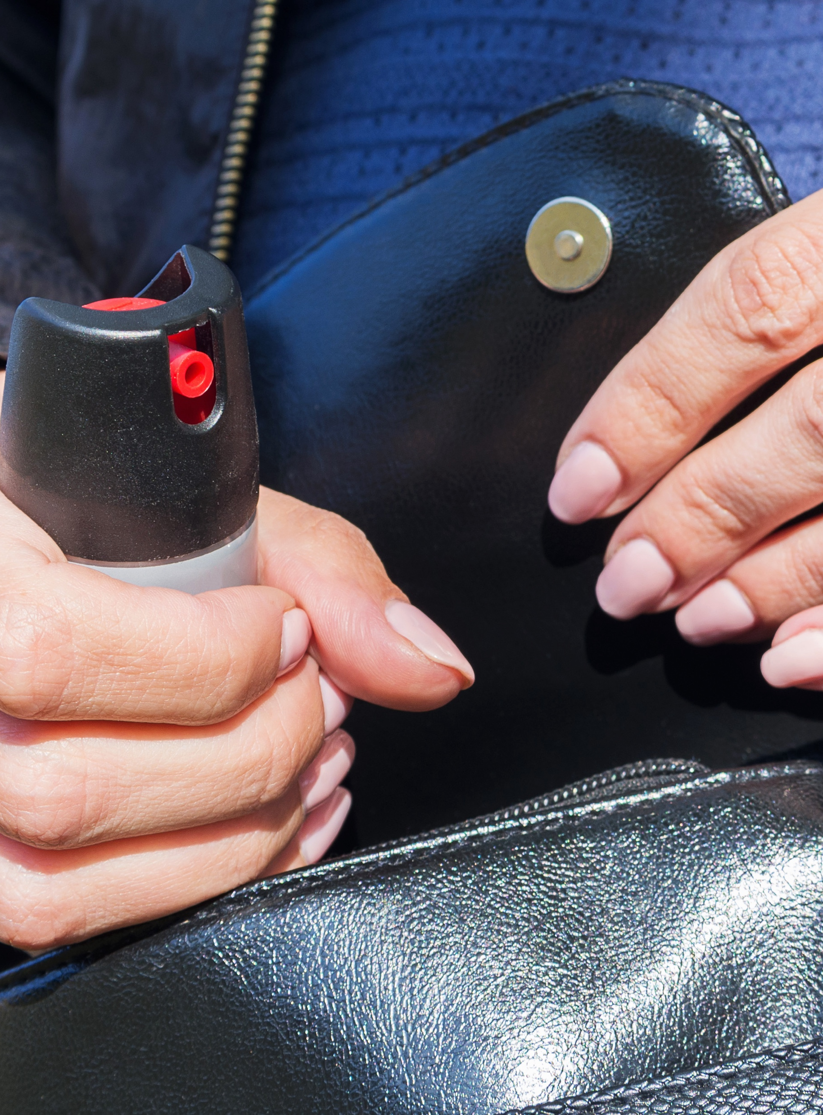
Should You Try to Defend Yourself?
Fighting back:
A conscious decision when escaping is not an option

Slide 24
Can You Diffuse the Situation?
Buy time to assess the situation, decide what to do
Create a distraction and escape
On the other hand,
  May trigger the attacker’s emotions
  May justify an attack (in the predator’s mind)

Slide 25
Should You Take a Self-Defense Class?
Benefits
  Rehearse simulated confrontations
  Learn to recognize and evaluate threats
  Improve fitness
Gain confidence to:
  Handle threats
  Choose right response
  Defend yourself
  Calm fear responses

Slide 26
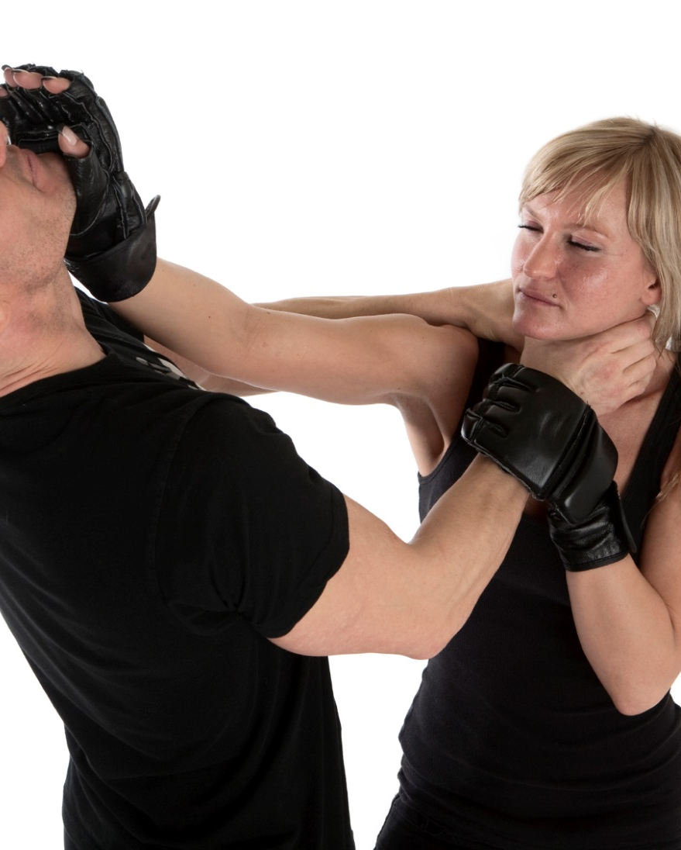
Choosing a Self-Defense Class
Ask family, friends, and colleagues
Observe a class
Ask about the training goals
Match your fitness level
Choose group instruction
Check for safety precautions
No-pressure environment

Slide 27
Should Your Arm Yourself?
Personal choice
Comply with all state and local laws
Follow best practices for firearm safety
Learn to use the weapon for self-defense
Consider other options for self-defense weapons: sprays, baton, Taser

Slide 28
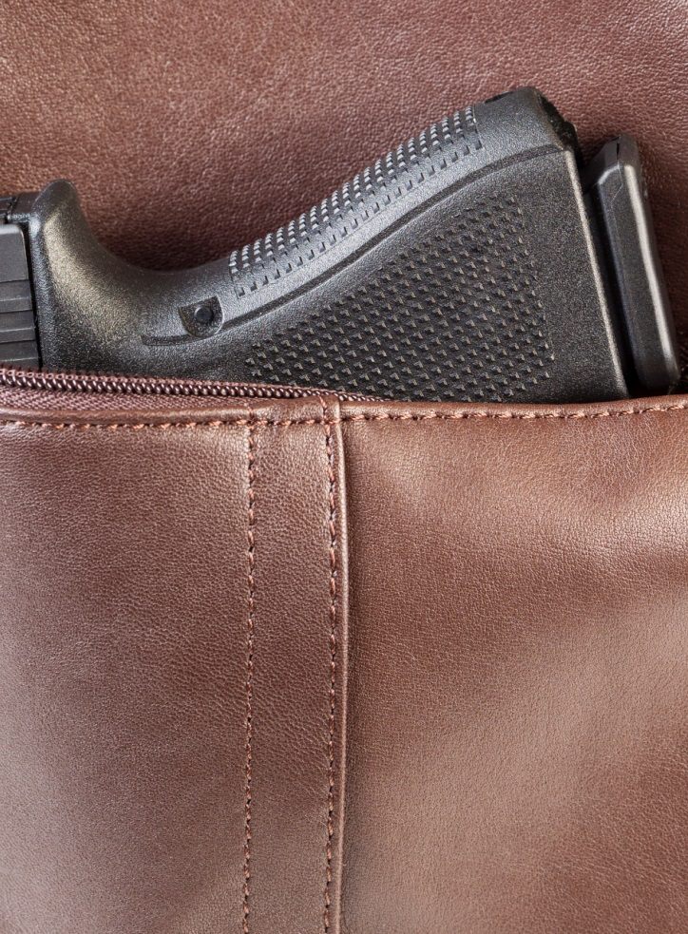
Learn to Use Weapons for Self-Defense
A weapon is a liability if an attacker can take it away and use it against you
Learn how to use it properly for self-defense
Know and comply with your state’s weapons laws

Slide 29

Your Smartphone—Your Personal Safety Tool
GPS tracking
Texting
Alerts and alarms
Photo sharing
Surveillance
Call blockers

Slide 30
Do You Know the Caller?
You can be tricked into a conversation with someone you don’t know
Scammers feed off your reactions
Listen to your instincts
If you don’t remember the caller, you’ve probably never met

Slide 31
Calls to 911––You Should Know
Where do 911 calls go?
Response time?
Can the emergency system locate you?
Is the system GPS enabled?
Can the emergency operator call back?
Can police provide extra patrols during open-house events or around vacant properties?
How/when should you report non-emergencies?

Slide 32
8 Criteria for Choosing Safety Products
Supports behavioral and cultural change
Designed for prevention
Rooted in behavioral science
Alerts emergency contacts based on proximity
Two types of alerts: uncomfortable vs. emergency
Unobtrusive––will not make legitimate prospects uncomfortable
Helps identify “red flags”
Integrated with 911

Slide 33
Auto Safety
Drive separately or be the driver
Keep your car in top operating condition
Store breakdown essentials in trunk
Know where you are going
Avoid aggressive drivers or road rage situations
No texting or multitasking while driving
  The average time your eyes are off the road while texting is 5 seconds (enough time to cover the length of a football field–– blindfolded)

Slide 34
Parking Lot Safety
Keep keys out and ready to open the car door
Unlock only the driver-side door
Check the back seat
Lock all doors immediately upon entering and get moving
Keep car keys on a separate key ring from house and office keys

Slide 35
More Safety Tips
Know who is calling
Keep your cell phone ready to use
Personal location devices––GPS wearables
Know where you are going
Roadside service
Cold weather essentials
Stalking is a predatory crime

Slide 36
Module 3:
Safety With Buyers

Slide 37
First Meetings
CITO––Come Into The Office
Standard office policy
  Prospect Identification Form
  Photocopy the ID and attach it to the form
  Snap a photo of the prospect’s ID and send it to the office
Be wary of email contacts who refuse to provide a full name

Slide 38
Equal Professional Services
Procedures or forms used to collect information from prospects must be applied consistently
Inconsistent application could be viewed as discriminatory
  REALTORS® shall not deny equal professional services to any person for reasons of race, color, religion, sex, handicap, familial status, national origin, sexual orientation, or gender identity.
  National Association of REALTORS®, Code of Ethics, Article 10

Slide 39
Background Checks? Yes or No?
No national database with complete and accurate criminal records
Inconsistent classification and delayed reporting
Percentage of crimes reported
  46% robberies
  37% simple assaults
  52% aggravated assaults
  33% rape and sexual assaults

Slide 40
Who Knows Your Location?
Office should know your property showing itinerary
Take a showing buddy
Calls and alerts
  Call or text the office to confirm your arrival
  Ask for a call back
  Set an alarm
Ask the prospect to step outside while you secure the property
Notify office when showing is finished and state where you are going next

Slide 41

Distress Codes
Secret word or phrase to signal danger (e.g., “Could you email me the easement file?”)
What code words do you use?

Slide 42
Arriving at the Property––Prepare the Home
Turn on all the lights
Open drapes and blinds
Unlock exterior doors
Open interior doors
Open garage door
Clear obstructions
Put away dangerous objects
Position surveillance cameras

Slide 43
Setting the Tone
How and where you greet the arriving prospect
Set an authoritative and in-control tone
Maintain a social distance of about 5–7 feet from a prospect

Slide 44
Risky Locations
Bedrooms and bathrooms
Closets and pantries
Out buildings
Garages
Basements
Stairs
  Prospect goes up or down the stairs first
  Maintain a four-stair difference
  Prospect moves away from the top or bottom of the stairs before you complete the ascent or descent
  Keep a grip on the handrail

Slide 45
Showing Vacant Properties
Learn the house before you show it
Squatter inside? Leave immediately and call the police.
Angry former homeowner? Apologize for the disturbance and leave.
  Call lender, asset management company, or listing agent
Meet the neighbors
No after-dark showings

Slide 46
Commercial Properties
Schedule showings of vacant commercial sites during daylight hours
Thick walls and remote locations may interfere with cell phone reception

Slide 47
Showing a Property After Dark
Ineffective way to show a property
Turn on all lights as you go through
Open all shades, curtains, or blinds
Advise your supervisor of the appointment time
Take a showing buddy

Slide 48
Red Flags
Is an attack imminent?
Predator “testing the waters”
Attempt to isolate the victim
Escalation from professional to personal
Invasion of body space
Uninvited touching
Personal questions

Slide 49
Body Language
Looking out the window
  Lack of eye contact
  Hands in the pockets
  Cool weather clothing in warm weather
  Dilated pupils
  Changes in breathing or facial expression
  Visible veins
  Wiping hands
  Fidgeting

Slide 50
Verbal Signals
More interest in you than in the house
  Issuing orders
  Asking you to move closer
  Sharing excessive personal information
  Suggestive language that is too familiar or intimate
  Inappropriate compliments
  Speaking louder, faster, or in a sharper tone

Slide 51
More Safety Tips
Quick exit
Carry essentials only
Take a photo
Check your surroundings
Lock up
Use your car key fob
Don’t say vacant
Wear flat-heeled shoes
Evaluate the risk

Slide 52
Module 4:
Safety with Sellers

Slide 53

Listing Appointment Safety
Could be a lure
Who referred the caller?
Check out the property, prospect, and neighborhood
Use the Evaluate, Assess, React Worksheet
Watch for “red flags”
If it doesn’t feel right, leave immediately

Slide 54
Showing Safety for Sellers
Include seller safety awareness in listing presentation
Provide tips and suggestions for safeguarding valuables and information
Caution that other agents may not take the same precautions

Slide 55
Staging for Safety
Remove obstacles
Secure or temporarily remove pets
Safeguard valuables, personal information––credit cards, bills, checkbooks, mail, bank statements, family photos, and schedules
Lock up firearms, ammunition, weapons, and knives, including the kitchen knife block
Increase security while on the market

Slide 56
Open House and Model Home Safety
No opportunity to screen prospects
Model homes in isolated locations
Use the buddy system
Familiarize yourself with the property––inside and outside
Keep office, family, or a friend informed of your whereabouts and schedule

Slide 57
Before the Open House
Carry only essentials
Familiarize yourself with the house and note confined areas to avoid
Plan two escape routes
Unlock the deadbolt locks for quick access to the outside
Check around the outside of the house
Keep basement and garage exits locked from inside
Check mobile phone strength and signal
Complete safety routine before admitting any visitors

Slide 58
Visitor Sign-in
Require sign-in
Ask for identification
State in publicity that identification is required
Maintain separate sign-in and registration lists at model homes

Slide 59
Closing Up
Most vulnerable time––never assume the home is vacant
Ask for help from a colleague, friend, or family at closing time
Inform a contact when you begin closing
Lock front door first
Check all window locks
Go from the top floor to the bottom and the back to the front, locking the doors behind you
Check the backyard and garage

Slide 60
Photograph and Virtual Tours
Virtual tours can be used to case a home
Items that will be removed for showing should be kept out of sight when shooting a video tour
Geotagging
  Embeds GPS metadata with digital photos
  Location data posted with photo
  Disable metadata on phones, cameras, but not GPS location tracking

Slide 61
More Safety Tips
Warn owners (and children) not to show their home by themselves
Know the agent
Lock up personal information
Lock up prescription medicines
Take a tour from a “stranger’s viewpoint”
Protect children’s identity
Identification required
Inform neighbors
Control open house traffic
Watch out for the “white glove” test
Perform post-showing check
Place a “not for rent” sign in the window
Increase surveillance
Notes:
Watch out for the “white glove” test: Do open house visitors run their fingers along the tops of windows like they are testing for dust? This could be a ploy to unlock a window for later entry and theft.

Slide 62
Thank you for participating in this course!

