Slide 1
Purpose of Notarizing Documents
Why We Notarize At All?
Power of Official Impartial Witness
Heightened identity validation
Shield against duress, coercion
Conveys solemnity of transaction
Evidentiary Role: Seal and a Record

Slide 2
Electronic and Remote Notarization: Terms
“Remote” and “online” notarizations are all eNotarizations or “electronic” notarizations
An eSignature is an “original” signature
“Presence” before the notary via audio-video communication
“Identity verification” in the online world

Slide 3
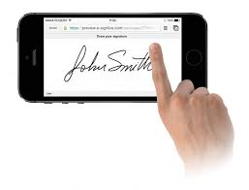
Electronic Process: Governing Law
Federal E-Sign Act
Uniform Electronic Transactions Act
Uniform Real Property Electronic Recording Act
Validity of electronic documents
A. If a law requires, as a condition for recording, that a document be an original, be on paper or another tangible medium or be in writing, the requirement is satisfied by an electronic document satisfying this article.
B. If a law requires, as a condition for recording, that a document be signed, the requirement is satisfied by an electronic signature.

Slide 4
Interstate Recognition of Notarized Documents
Interstate Recognition of Notarial Acts
Virtually every state recognizes and accepts documents duly notarized by notaries in other states
Recorders have been recording documents notarized in other states under these laws for many years
Any jurisdiction equipped to accept electronic filings can accept electronically notarized documents

Slide 5
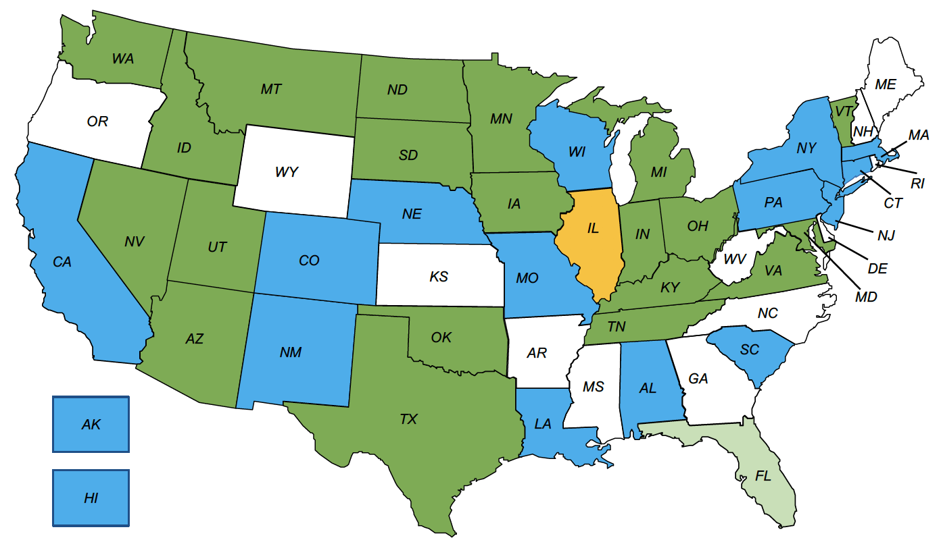
Legislative Map 2018-19
States in GREEN have enacted legislation. (Those in light green await the Governor’s signature).
States in BLUE have legislation pending or are likely to introduce it in the 2019 session.
States in ORANGE have task forces or other working groups (formally or informally) currently in progress.

Slide 6
Legislative Model Laws Update
Model Laws: Remote Notarization
Uniform Law Commission: RULONA 2018
Mortgage Bankers Association/American Land Title Association
NNA’s Model Electronic Notary Act (MENA)
Regulations: TX, NV, TN

Slide 7
Interstate Recognition of Notarized Documents
How It Works: Simple Demo
General Demo Video
https://www.notarize.com/signer/how-to

Slide 8
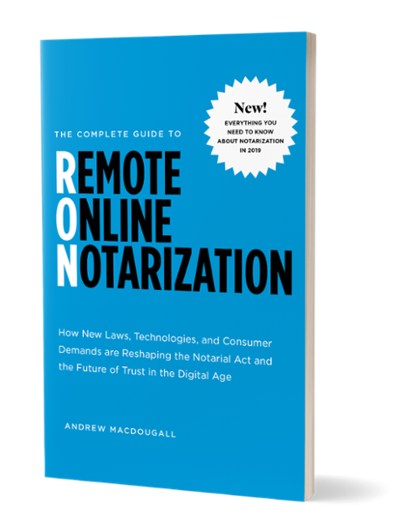
FREE EBOOK
The Complete Guide to Remote Online Notarization
How New Laws, Technologies, and Consumer Demand Are Reshaping the Notarial Act and the Future of Trust in the Digital Age.
Grab your FREE COPY 👉 notarize.com/book

