Slide 1
Financialwellness.realtor

Slide 2
Helping Your Agent Through an Economic Market Downturn: A Survival Guide for Brokers
Recording Available: Monday, April 6th

Slide 3
Webinar site:
Nar.realtor/cffw/webinarS

Slide 4
CENTER FOR REALTOR® FINANCIAL WELLNESS WEBINAR AND SEMINAR DISCLAIMER
For Education and Information Purposes Only
Please note that the information and materials provided in Center for REALTOR® Financial Wellness webinars and seminars are not intended or provided to be used as a substitute for the advice of your tax, investment, legal and/or financial advisors or to be the basis of specific financial planning activities. The opinions and views expressed or shared in this presentation represent only those of the developers, speakers, presenters or instructors and have not been endorsed or approved by the National Association of REALTORS®. While substantial care is taken to try to provide accurate and current data and information, the National Association of REALTORS® does not warrant the accuracy, completeness or timeliness of any data and information provided in the webinars and seminars. Further, any principles and conclusions presented are subject to court decisions and to local, state and federal laws and regulations and any revisions of such laws and regulations. If you seek or need tax, investment, legal or financial advice, you must obtain such advice and services from the appropriate professionals.
Any links to third-party websites, tools, materials or resources are provided as a convenience and for your information. Any products, services or opinions of third-party entities or associated individuals are neither endorsed nor have they been vetted by the National Association of REALTORS®, and their inclusion in the webinar or seminar and any related materials do not constitute a recommendation by the National Association of REALTORS® and should not be inferred as suggesting a preference over other products, services or information available in the market. The National Association of REALTORS® bears no responsibility for the accuracy, completeness, legality or the content provided in the webinar or seminar and any related materials.

Slide 5
Presenter: Tim Vohar
REALTOR®, Managing Broker - Norfolk
Director of Education & Training
Graduate Realtor® Institute

Slide 6
Helping Your Agent Through an Economic Market Downturn: A Survival Guide for Brokers
tim vohar, gri
~reminding you of the tasks you already know to do, and
helping you become more efficient doing them~

Slide 7
Today’s Agenda
Welcome & Introduction
Staying in Touch
Handling COVID-19 Feedback ~ Clients & Agents
Contract Strategies
Agents and their Sphere of Influence Contact
Encouraging Agents to Save and Other Must Do Tasks
Evaluate Your Business and Marketing Plans
Supporting and Encouraging
This Photo by Unknown Author is licensed under CC BY-SA

Slide 8
Your Instructor: Tim Vohar
Licensed since 1999 in Virginia and North Carolina (2004)
Rookie of the Year – 1999
Award Winning Recipient – 1999-2006
Instructing since 2002, full-time Manager/Instructor since 2006
HRRA Code of Ethics Recipient – 2015
Virginia Instructor of the Year Nominee – 2019
Certified Ethics & Fair Housing Instructor
Licensed Instructor in Virginia
REBAC, GRI & Continuing Education instructor

Slide 9
Staying in Touch

Slide 10
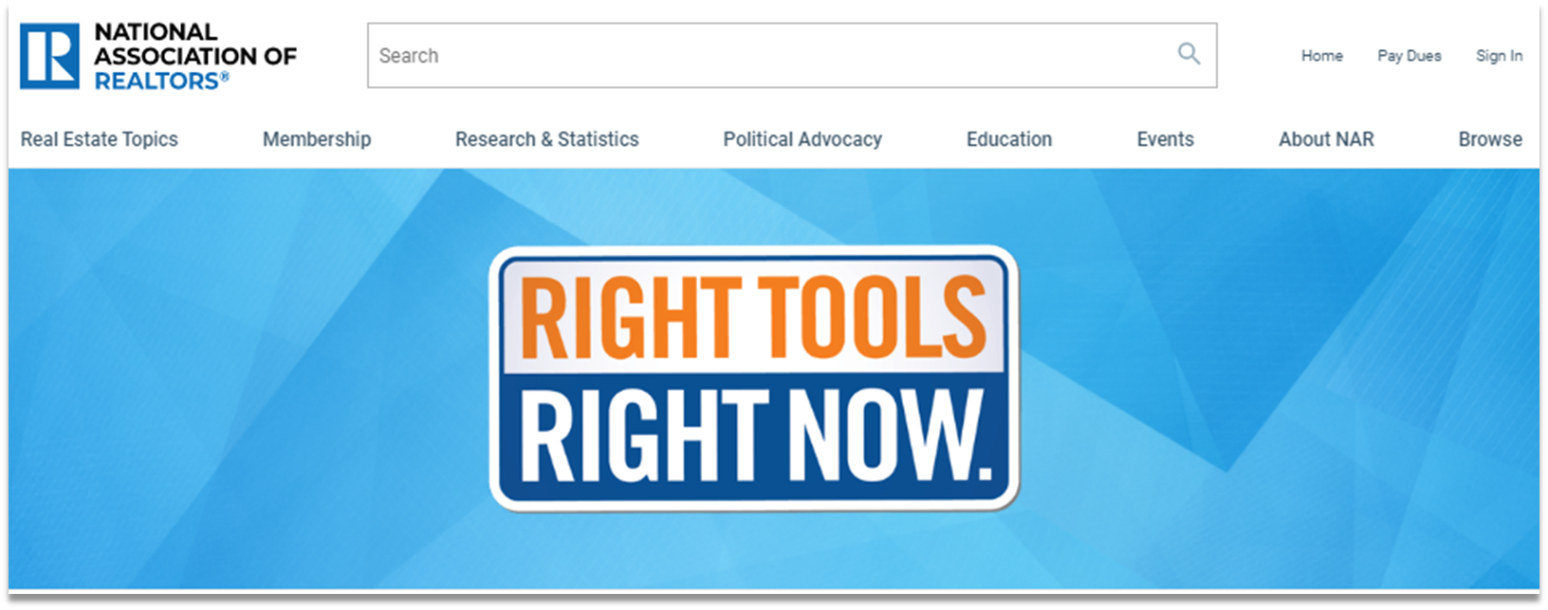
Member Resource
nar.realtor/right-tools-right-now 1-800-874-6500
Notes:
The COVID-19 health crisis has forced dramatic change upon our business more quickly than we have ever seen. NAR is taking steps to support you now. Through Right Tools, Right Now, a program first activated in 2009 in the midst of the financial crisis, you’ll find new and existing NAR products and services available for FREE or at significant discounts. The program includes products, resources, and services from all areas of NAR, including:
Webinars
Education courses to expand your skills;
And timely market reports to inform your business and clients.
These are just a couple of the outstanding offers available now. Visit the page often as new offers will be added regularly.
If you need help finding any resources, or have questions related to COVID-19 and real estate, NAR's Member Support Team is also ready to help. Their hotline is, 1-800-874-6500. Call between 8 a.m. and 6 p.m. CDT, Monday–Friday.
Please know that NAR is here to support you. Please take advantage of these benefits available through Right Tools, Right Now by visiting - nar.realtor/right-tools-right-now.

Slide 11
#1 Task We Have in Crisis or Regular Times….
STAY
CONNECTED
with your agents

Slide 12
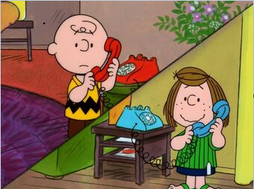
What do you do now?
Face to Face ~ switch to an online video platform
Calls ~ Keep Calling Your Agents
Notecards ~ Keep Mailing Your Agents
e-Mails ~ Keep e-Mailing Your Agents
Texts ~ Keep Texting Your Agents
Meetings ~ switch to an online video platform
DO these tasks more Frequently!
This Photo by Unknown Author is licensed under CC BY-NC-ND
Notes:
ASK How many people have started setting up/holding on-line meetings either 1 on 1 or group?

Slide 13
“Looping” With Your Agents
Email: Tim@BHHSTowne.com
Notes:
THIS IS WHAT MY FIRM’S MANAGERS USE ON A REGULAR BASIS, IF YOU DON’T HAVE ONE NOW IS THE TIME TO START! DOES EVERYONE HAVE SOME KIND OF TRACKING SHEET LIKE THIS? If No and you would like a copy, please { email type in the chat}

Slide 14
Handling COVID-19 Feedback

Slide 15
First, Always Be You Because this crisis will end, and we will resume life
Your agents chose you for YOU and stay with you because you are YOU!
This Photo by Unknown Author is licensed under CC BY
This Photo by Unknown Author is licensed under CC BY
Notes:
Make a list of your best qualities as a person, as a real estate agent, as a real estate manager, make a list of the traits you can improve on or know you need to work. Identifying who you are will help you go along way!

Slide 16
First, Always Be You Because this crisis will end, and we will resume life
Your agents chose you for YOU and stay with you because you are YOU!
Don’t change who you are because it’s a crisis, be a better version of you
This Photo by Unknown Author is licensed under CC BY
This Photo by Unknown Author is licensed under CC BY
Notes:
Make a list of your best qualities as a person, as a real estate agent, as a real estate manager, make a list of the traits you can improve on or know you need to work. Identifying who you are will help you go along way!

Slide 17
First, Always Be You Because this crisis will end, and we will resume life
Your agents chose you for YOU and stay with you because you are YOU!
Don’t change who you are because it’s a crisis, be a better version of you
If you are a worrier, it’s not the time to worry more, its time to be stronger
This Photo by Unknown Author is licensed under CC BY
This Photo by Unknown Author is licensed under CC BY
Notes:
Make a list of your best qualities as a person, as a real estate agent, as a real estate manager, make a list of the traits you can improve on or know you need to work. Identifying who you are will help you go along way!

Slide 18
First, Always Be You Because this crisis will end, and we will resume life
Your agents chose you for YOU and stay with you because you are YOU!
Don’t change who you are because it’s a crisis, be a better version of you
If you are a worrier, it’s not the time to worry more, its time to be stronger
If you are not a worrier, its time you became more compassionate
This Photo by Unknown Author is licensed under CC BY
This Photo by Unknown Author is licensed under CC BY
Notes:
Make a list of your best qualities as a person, as a real estate agent, as a real estate manager, make a list of the traits you can improve on or know you need to work. Identifying who you are will help you go along way!

Slide 19
First, Always Be You Because this crisis will end, and we will resume life
Your agents chose you for YOU and stay with you because you are YOU!
Don’t change who you are because it’s a crisis, be a better version of you
If you are a worrier, it’s not the time to worry more, its time to be stronger
If you are not a worrier, its time you became more compassionate
If you are empathetic already, don’t turn sympathetic
This Photo by Unknown Author is licensed under CC BY
This Photo by Unknown Author is licensed under CC BY
Notes:
Make a list of your best qualities as a person, as a real estate agent, as a real estate manager, make a list of the traits you can improve on or know you need to work. Identifying who you are will help you go along way!

Slide 20
First, Always Be You Because this crisis will end, and we will resume life
Your agents chose you for YOU and stay with you because you are YOU!
Don’t change who you are because it’s a crisis, be a better version of you
If you are a worrier, it’s not the time to worry more, its time to be stronger
If you are not a worrier, its time you became more compassionate
If you are empathetic already, don’t turn sympathetic
If you are sympathetic, be more empathetic
This Photo by Unknown Author is licensed under CC BY
This Photo by Unknown Author is licensed under CC BY
Notes:
Make a list of your best qualities as a person, as a real estate agent, as a real estate manager, make a list of the traits you can improve on or know you need to work. Identifying who you are will help you go along way!

Slide 21
First, Always Be You Because this crisis will end, and we will resume life
Your agents chose you for YOU and stay with you because you are YOU!
Don’t change who you are because it’s a crisis, be a better version of you
If you are a worrier, it’s not the time to worry more, its time to be stronger
If you are not a worrier, its time you became more compassionate
If you are empathetic already, don’t turn sympathetic
If you are sympathetic, be more empathetic
People can feel fear and fake, don’t leave here trying to be something you are not, leave here thinking ~ HOW CAN I BE A BETTER ME?
This Photo by Unknown Author is licensed under CC BY
This Photo by Unknown Author is licensed under CC BY
Notes:
Make a list of your best qualities as a person, as a real estate agent, as a real estate manager, make a list of the traits you can improve on or know you need to work. Identifying who you are will help you go along way!

Slide 22
The Questions
First, what is/are your localities lock-down, shelter-in-place orders?
Second, does your company’s policy have even more restrictive orders?
Should we tell Buyers to wait?
Should we tell Sellers to wait?
This Photo by Unknown Author is licensed under CC BY-NC-ND

Slide 23
The Tools
What do we do about showings? (If you can still conduct in person showings?)
Should we cancel Open Houses? Yes and No
Paradym
Matterport
Facebook Live
Vimeo
Youtube

Slide 24
SOME RESOURCES BESIDES NAR
T3 Sixty –
Tactical Tuesdays
Fireside Fridays
RISMedia -
Strategies for Handling Objections and Consumer Concerns
Keep the long game in mind.
Focus on the positive.
Leverage technology.
Don’t ignore the truth.
Notes:
I typically try to stay with the ones that are positive, upbeat and shorter. Attention span and information overload!

Slide 25
Contract Strategies

Slide 26
Use COVID-19 Addendums
Associations, state and local
Multiple Listing Services
Your Brokerage Firms
Attorneys/Settlement Agents
Lenders, if applicable
This Photo by Unknown Author is licensed under CC BY
Notes:
Some addendums are for the sellers and buyers, Some add in inspectors, appraisers, most are a days added on contingency, the majority are with hopeful successful conclusions rather than terminations. HAVE You read yours and understand yours? NEVER comment on an addendum until you have read the specific to that contract version! Even if you think you know what it says, how many times have we seen a contract changed by an agent???

Slide 27
Sphere of Influence Contact

Slide 28
You Have to Encourage Agents to Stay Engaged
Social Media
This Photo by Unknown Author is licensed under CC BY-SA

Slide 29
You Have to Encourage Agents to Stay Engaged
Social Media
Be USEFUL and HELPFUL, not hit them over the head salespersony
Encourage good Social Behavior, though FUN is important

Slide 30
You Have to Encourage Agents to Stay Engaged
Social Media
Be USEFUL and HELPFUL, not hit them over the head salespersony
Encourage good Social Behavior, though FUN is important
Calls – don’t text, CALL, people want to TALK, if they don’t, they wont answer!

Slide 31
You Have to Encourage Agents to Stay Engaged
Social Media
Be USEFUL and HELPFUL, not hit them over the head salespersony
Encourage good Social Behavior, though FUN is important
Calls – don’t text, CALL, people want to TALK, if they don’t, they wont answer!
“I have some EXTRA toilet paper, hand sanitizer…”
To the Seniors “May/Can I do your grocery shopping for you?” Or “Did you know ABC grocery store has senior hour from {fill in the blank}”

Slide 32
You Have to Encourage Agents to Stay Engaged
Social Media
Be USEFUL and HELPFUL, not hit them over the head salespersony
Encourage good Social Behavior, though FUN is important
Calls – don’t text, CALL, people want to TALK, if they don’t, they wont answer!
“I have some EXTRA toilet paper, hand sanitizer…”
To the Seniors “May/Can I do your grocery shopping for you?” Or “Did you know ABC grocery store has senior hour from {fill in the blank}”
Websites

Slide 33
You Have to Encourage Agents to Stay Engaged
Social Media
Be USEFUL and HELPFUL, not hit them over the head salespersony
Encourage good Social Behavior, though FUN is important
Calls – don’t text, CALL, people want to TALK, if they don’t, they wont answer!
“I have some EXTRA toilet paper, hand sanitizer…”
To the Seniors “May/Can I do your grocery shopping for you?” Or “Did you know ABC grocery store has senior hour from {fill in the blank}”
Websites
Activities to do while at home
Books to read
Shows to watch
Games to play

Slide 34
You Have to Encourage Agents to Stay Engaged
Social Media
Be USEFUL and HELPFUL, not hit them over the head salespersony
Encourage good Social Behavior, though FUN is important
Calls – don’t text, CALL, people want to TALK, if they don’t, they wont answer!
“I have some EXTRA toilet paper, hand sanitizer…”
To the Seniors “May/Can I do your grocery shopping for you?” Or “Did you know ABC grocery store has senior hour from {fill in the blank}”
Websites
Activities to do while at home
Books to read
Shows to watch
Games to play
e-Newsletters – all the above!

Slide 35
You Have to Encourage Agents to Stay Engaged
Social Media
Be USEFUL and HELPFUL, not hit them over the head salespersony
Encourage good Social Behavior, though FUN is important
Calls – don’t text, CALL, people want to TALK, if they don’t, they wont answer!
“I have some EXTRA toilet paper, hand sanitizer…”
To the Seniors “May/Can I do your grocery shopping for you?” Or “Did you know ABC grocery store has senior hour from {fill in the blank}”
Websites
Activities to do while at home
Books to read
Shows to watch
Games to play
e-Newsletters – all the above!
If they do mailing keep them going if possible
Notes:
Mailings need to be discussed. Safety? Cost?

Slide 36
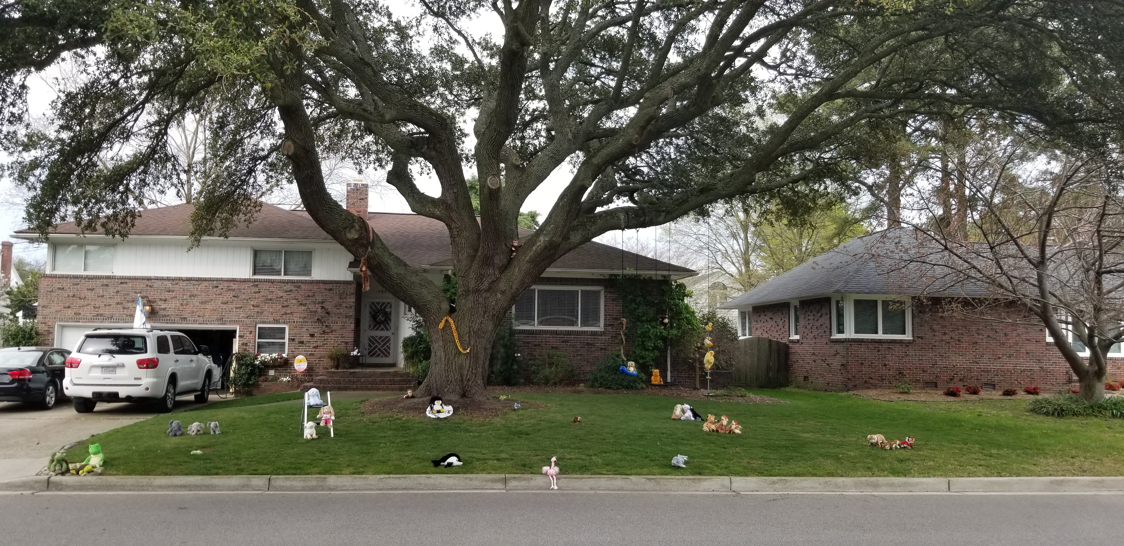
Talbot Park Stuffed Animal Safari, March 27, 2020

Slide 37
Encouraging Agents to Save and Other Must Do Tasks

Slide 38
Limit Spending wherever possible
Print ads? Limit, scale back
Non-Specific collateral pieces, scale back to eliminate
Property Staging
Don’t replace technology,
but if you don’t have it you might need to invest
Limit shopping, don’t online spend on things we don’t need like shoes & clothes
Eat leftovers and don’t waste food (this is for me ☺)
This Photo by Unknown Author is licensed under CC BY-NC-ND

Slide 39
Other Items Agents Should Do Now
Work on Continuing Education, Post Licensure, Broker education classes
Take on-line classes through NAR, State & Local Associations, MLS’s
Subscribe AND read real estate news blogs
Work on Listing Presentation and Buyer Counseling Interviews
Practice/Study Market Analysis reports for their service areas
Work on their Business and Marketing Plans
Learn to use the Technology you offer, or they have BETTER

Slide 40
FinancialWellness.realtor
Notes:
NAR has also provided another great resource for you through the Center for REALOTR® Financial Wellness. Visit FinancialWellness.realtor to download a personal budget spread sheet.
This is a great way for you to track your personal expenses and cut back where you see fit. Categories in the spreadsheet include:
Housing
Transportation
Entertainment
Loans
Food
Gifts and Donations
Taxes
Insurance
And so much more…
Again, visit FinancialWellness.realtor to access this FREE tool.

Slide 41
Evaluate YOUR Business & Marketing Plans

Slide 42
Thoughts to Ponder
Do I know how to do MY Administrators jobs & tasks
Do I know how to use all the vital & essential software
Do I know how to input listings into the MLS, make changes
Do I know the process and am I capable of ensuring EMDs are deposited appropriately and on time
Do I know where the money is being spent AUTOMATICALLY that can/should/needs to be stopped coffee, snacks, paper, toner, advertising
Can I work from home if I need to/have to/ordered to? Can I do things that I can make it possible?

Slide 43
Where does the Money Go
Review your P&L Statements, do a deep dive into the line items and look at specific sub line items or invoices
This Photo by Unknown Author is licensed under CC BY-SA-NC

Slide 44
Where does the Money Go
Review your P&L Statements, do a deep dive into the line items and look at specific sub line items or invoices
Label the cost as Vital & Essential or Discretionary, label each A, B, C
A- Can't operate with out
B- Can operate but work is harder
C- Can operate but will need to address
If it doesn’t get A,B,C think about why are you doing it in the first place and stop it now
This Photo by Unknown Author is licensed under CC BY-SA-NC

Slide 45
Where does the Money Go
Review your P&L Statements, do a deep dive into the line items and look at specific sub line items or invoices
Label the cost as Vital & Essential or Discretionary, label each A, B, C
A- Can't operate with out
B- Can operate but work is harder
C- Can operate but will need to address
If it doesn’t get A,B,C think about why are you doing it in the first place and stop it now
Look at your Marketing spends
This Photo by Unknown Author is licensed under CC BY-SA-NC

Slide 46
Where does the Money Go
Review your P&L Statements, do a deep dive into the line items and look at specific sub line items or invoices
Label the cost as Vital & Essential or Discretionary, label each A, B, C
A- Can't operate with out
B- Can operate but work is harder
C- Can operate but will need to address
If it doesn’t get A,B,C think about why are you doing it in the first place and stop it now
Look at your Marketing spends
Look at your Advertising spends
Print
Digital
This Photo by Unknown Author is licensed under CC BY-SA-NC

Slide 47
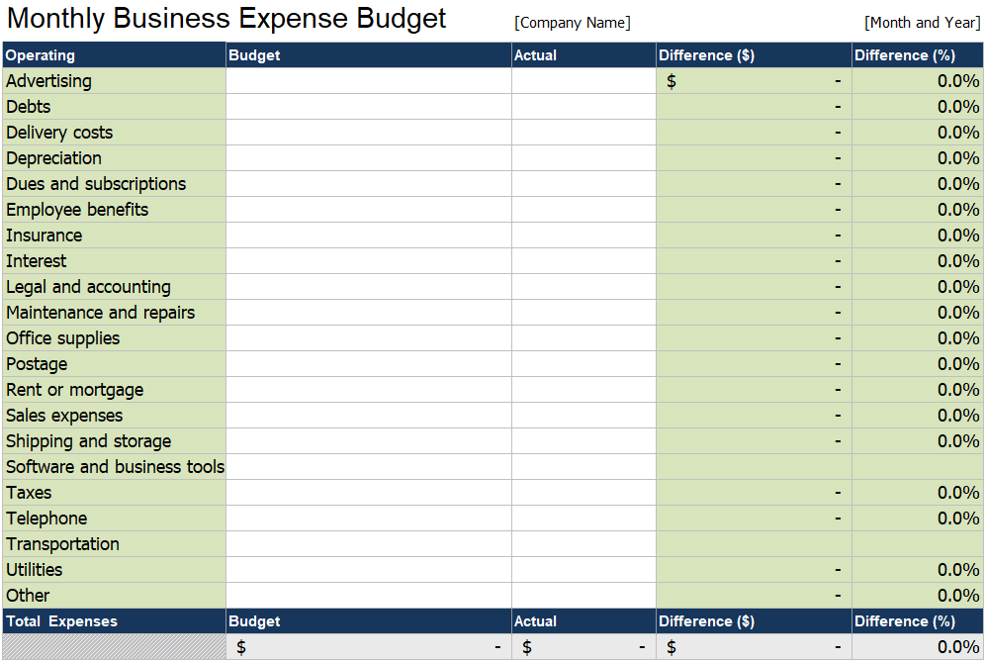
FinancialWellness.realtor
Notes:
The Center for REALOTR® Financial Wellness has provided another great resource that we can use as a refresher or share with our agents.
Visit FinancialWellness.realtor to download a monthly business expense budget spread sheet.
This document is thorough and detailed which can be a great resource to offer our newer agents. For example, it takes into account:
Dues and subscriptions
Advertising and postage
Transportation
As a broker, use it for
Software and business tools expenses
Employee benefits
Insurance
Etc.
Encourage your agents to develop a good habit of separating their business expenses from their personal, and if they need help getting started – I would suggest using this tool.
Best part, it’s FREE! Again, visit FinancialWellness.realtor.

Slide 48
NAR Resource – nar.realtor/coronavirus
Notes:
As a business owner, many of us know…
Congress passed a $2 trillion COVID-19 economic relief package on March 27, 2020 with overwhelming bipartisan support.
As more guidance is released by the Administration on how these new programs will be implemented, updates will be provided on nar.realtor/coronavirus.
Visit the site to learn more about the provisions.
Topics will cover:
Housing
Credit Reporting & Student Loans
Small Business Administration Provisions
Infrastructure
Tax
Unemployment Benefits for Self-Employed
Lastly, details on the Families First Coronavirus Response Act (FCCRA) Amendments
Again, this is a resource provided by NAR, and I strongly encourage you to visit nar.realtor/coronavirus to learn more and how this can benefit your business.

Slide 49
Supporting and Encouraging

Slide 50
How we will come together & move forward
Be
Be You
Be Better
Be A Better You
Be A Better You Today
Be A Better You Tomorrow

Slide 51
How we will come together & move forward
Be
Be You
Be Better
Be A Better You
Be A Better You Today
Be A Better You Tomorrow
CHOOSE to Be BETTER, time is all we want…
…and it’s the only thing we can’t get any more

Slide 52
if you don't work now, when will you?
Thank you for listening, I hope you remain healthy!

Slide 53
Questions?
Ask in the chat
Or send an email to:
Financialwellness@nar.realtor
Ask Tim - Email: Tim@BHHSTowne.com

Slide 54
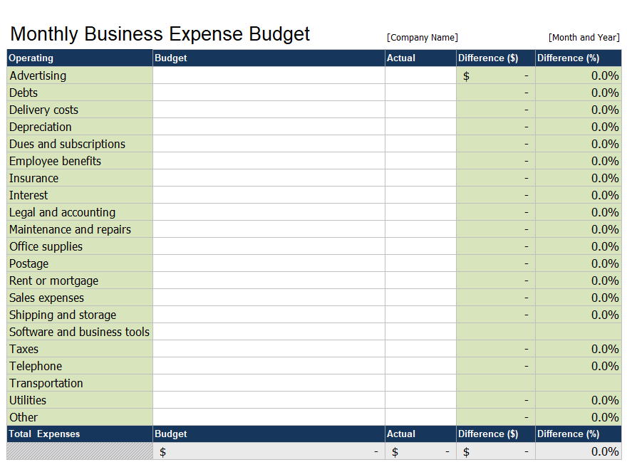
Additional Resources visit: FinancialWellness.realtor

Slide 55
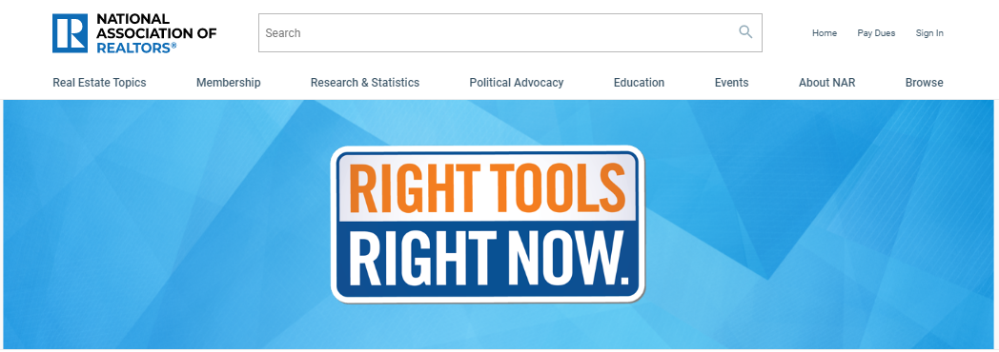
Member Resources: nar.realtor/right-tools-right-now

Slide 56
Thank You For Your Time
Webinar Recording Available:
Monday, April 6th
Visit – nar.realtor/cffw/webinars
FOR MORE INFORMATION or QUESTIONS EMAIL:
financialwellness@nar.realtor
Notes:
Welcome…

Slide 57
1. Visit FinancialWellness.realtor 2. Leave us your feedback. 3. Register for the next webinar. Thanks!

