Slide 1
Financialwellness.realtor

Slide 2
The Golden Handoff
Recording Available: Friday, June 19th

Slide 3
NAR.realtor/cffw/webinars

Slide 4
CENTER FOR REALTOR® FINANCIAL WELLNESS WEBINAR AND SEMINAR DISCLAIMER
For Education and Information Purposes Only
Please note that the information and materials provided in Center for REALTOR® Financial Wellness webinars and seminars are not intended or provided to be used as a substitute for the advice of your tax, investment, legal and/or financial advisors or to be the basis of specific financial planning activities. The opinions and views expressed or shared in this presentation represent only those of the developers, speakers, presenters or instructors and have not been endorsed or approved by the National Association of REALTORS®. While substantial care is taken to try to provide accurate and current data and information, the National Association of REALTORS® does not warrant the accuracy, completeness or timeliness of any data and information provided in the webinars and seminars. Further, any principles and conclusions presented are subject to court decisions and to local, state and federal laws and regulations and any revisions of such laws and regulations. If you seek or need tax, investment, legal or financial advice, you must obtain such advice and services from the appropriate professionals.
Any links to third-party websites, tools, materials or resources are provided as a convenience and for your information. Any products, services or opinions of third-party entities or associated individuals are neither endorsed nor have they been vetted by the National Association of REALTORS®, and their inclusion in the webinar or seminar and any related materials do not constitute a recommendation by the National Association of REALTORS® and should not be inferred as suggesting a preference over other products, services or information available in the market. The National Association of REALTORS® bears no responsibility for the accuracy, completeness, legality or the content provided in the webinar or seminar and any related materials.

Slide 5
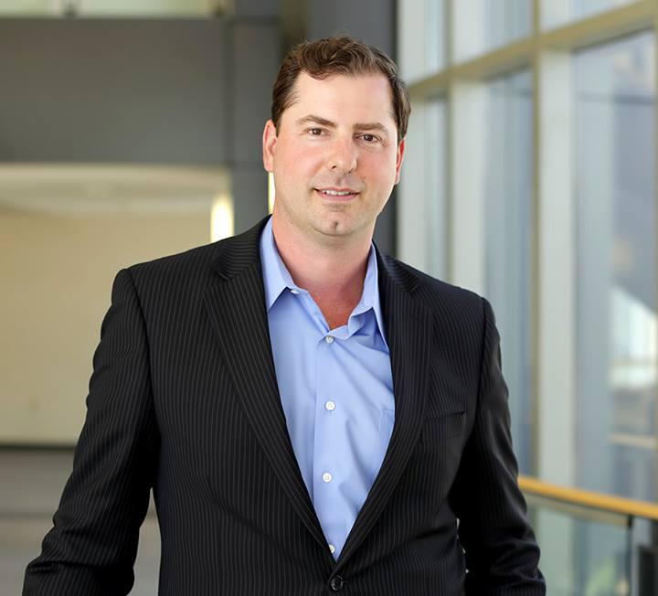
Presenter: Nick Krautter
CEO of City and State Real Estate

Slide 6
THE
GOLDEN
HANDOFF
BY NICK KRAUTTER

Slide 7
PAT HIBAN
BEST SELLING AUTHOR
6 STEPS TO 7 FIGURES
“The Golden Handoff identifies and lays out both a path that can help you learn from the success of others and accelerate the growth of your business. Nick Krautter does a brilliant job of explaining how he has successfully executed the Golden Handoff and how you can do the same. “
STEVE YEAGER
RICK DELUCA
VICE PRESIDENT,
SALES OLD REPUBLIC TITLE, OR
INTERNATIONAL
SPEAKER AND TRAINER
REAL ESTATE INSIDERS
“The Golden Handoff is the new playbook for any Brokerage that not only wants to recruit agents and grow their operation, but also wants to make sure that current business stays under their roof when agents retire. “
“To have watched Nick’s real estate career explode because of the principals he shares in this book has been one of the joys of my 39 year real estate career. If you’re looking for a step-by-step system to increase your real estate sales production – look no further. You’ve found it! “
ARE TALKING ABOUT THE GOLDEN HANDOFF:
JESSE GARCIA
LISA ARCHER
CEO OF PIPELINE WIZARD
CEO LIVE LOVE HOMES
“Nick Krautter has done a phenomenal job of documenting his success with one specific strategy that will increase every real estate professional’s business when implemented correctly. “
“What’s next in the real estate industry? After reading The Golden Handoff this is definitely something to learn, master and implement.”

Slide 8
THE GOLDEN HANDOFF
“I’ve interviewed over 500 of the nations top performers and Nick’s strategy presents a new model for agents. This book should be required reading for real estate professionals everywhere.”
Toby Salgado
SUPER AGENTS LIVE PODCAST
WWW.GOLDENHANDOFF.COM

Slide 9
THE GOLDEN HANDOFF
WE HAVE A PROBLEM
01
02
HOW DO I GROW
A BUSINESS?
HOW DO I
RETIRE?
WWW.GOLDENHANDOFF.COM

Slide 10
THE GOLDEN HANDOFF
SOLVES BOTH PROBLEMS
EXPONENTIAL
1 X 1
GROWTH
VS.
BY REFERRAL
1 X 300
WWW.GOLDENHANDOFF.COM

Slide 11
WHAT IS THE
VALUE OF A
BROKERAGE?
The value of the agents combined business.
WHAT IS THE
VALUE OF AN AGENT’S BUSINESS?
The number of clients X client referrals.

Slide 12
THE GOLDEN HANDOFF
HOW LONG DOES IT TAKE TO GROW YOUR BUISNESS TO 300 CLIENTS?
AN ENTIRE CAREER!
WWW.GOLDENHANDOFF.COM

Slide 13
THE GOLDEN HANDOFF
MY STORY
RENEE, DAVID
750 KW team leaders
Passive vs. Active Marketing
WWW.GOLDENHANDOFF.COM
A company is an association or collection of individuals, whether natural persons, legal persons, or a mixture of both. Company members share a common purpose and unite in order to focus their various talents and organize their collectively available skills or

Slide 14
THE GOLDEN HANDOFF
RENEE, DAVID
Two success stories showing the power of the Golden Handoff Model.
SALES VOLUME
GCI
YEAR 1: $2.5M
$60K
YEAR 2: $6.5M
$162K
YEAR 3: $4M
$97K
WWW.GOLDENHANDOFF.COM

Slide 15
THE GOLDEN HANDOFF
THE DEAL: REFERRAL AGREEMENT
YEAR
YEAR
YEAR
YEAR
01
02
03
04
NEW
REFERRALS
SPLIT
SPLIT
SPLIT
SPLIT
20%
70 / 30
80 / 20
90 / 10
0
WWW.GOLDENHANDOFF.COM
TITLE HERE

Slide 16
THE GOLDEN HANDOFF
WHY NOT SELL OUTRIGHT?
WWW.GOLDENHANDOFF.COM

Slide 17
THE GOLDEN HANDOFF
PREDICTING THE VALUE OF A DATABASE
RELATIONSHIP
STRENGTH
AA-
EFFORT
MARKET
VARIABILITY
WWW.GOLDENHANDOFF.COM

Slide 18
THE MONEY

Slide 19
THE GOLDEN HANDOFF
MONEY SOURCES
DIRECT
INCOME
INDIRECT-
SECONDARY
ADOPTED
REFERRALS
FUTURE
REFERRALS
CLIENTS OF THE RA
SIGN CALLS, POSTCARDS, MARKETING AROUND LISTING
WWW.GOLDENHANDOFF.COM
$59/MO

Slide 20
THE GOLDEN HANDOFF
HOW MANY DEALS CAN I EXPECT?
WWW.GOLDENHANDOFF.COM

Slide 21
THE GOLDEN HANDOFF
DEAL FLOW
200
75%
150
10
15
DEALS
PER YEAR
CLIENTS
REPEAT &
REFERRAL
DEALS
YEARS
[AVE. TIME
BETWEEN MOVES]
WWW.GOLDENHANDOFF.COM
TITLE HERE

Slide 22
THE GOLDEN HANDOFF
FINDING RETIRING AGENTS
WWW.GOLDENHANDOFF.COM

Slide 23
THE GOLDEN HANDOFF
FINDING RETIRING AGENTS
NETWORKING
MARKETING
PRODUCTION
ANALYSIS
Brokerage, Realtor Association, Community ect…
Outreach, Consistent Communication.
Slowing Down Before they Retire.
WWW.GOLDENHANDOFF.COM

Slide 24
THE GOLDEN HANDOFF
FINDING ADOPTING AGENTS
WWW.GOLDENHANDOFF.COM

Slide 25
THE GOLDEN HANDOFF
FINDING ADOPTING AGENTS
1
2
3
4
EXPERIENCE
RESOURCES
ETHICS
ENERGY
Can They List and Sell?
Time, Money, Team.
Honest Dealings
Do You Like Them?
WWW.GOLDENHANDOFF.COM

Slide 26
THE GOLDEN HANDOFF
WHO NOT TO HIRE
1
2
YOUR FRIEND
YOUR ASSISTANT
3
THE CHARASMATIC
NEW AGENT
4
THE AGENT THAT
NEEDS MORE BUSINESS
5
NOBODY
WWW.GOLDENHANDOFF.COM

Slide 27
THE GOLDEN HANDOFF
HOW IT WORKS
WWW.GOLDENHANDOFF.COM

Slide 28
THE GOLDEN HANDOFF
HOW IT WORKS
ADOPTING AGENT CONTACT
You connect with a successful agent to adopt your clients. This person is your Adopting Agent.
ANNOUNCEMENT
You announce you are retiring and the Adopting Agent will be taking care of your clients going forward.
COMMUNICATION
The Adopting Agent calls, emails and pro-actively communicates with your clients.
COLLECTION
You collect referral fees on any closed deals from your clients for the next three years!
WWW.GOLDENHANDOFF.COM

Slide 29
THE GOLDEN HANDOFF
THE DATABASE
CATEGORY:
A, B, C, Investor, Client, Friend, Relative, Past Client
NAME:
Johnny Homes
PHONE:
503-555-1234
EMAIL:
Johnnyhomes@aol.com
ADDRESS:
123 Main St. Portland, OR 97214
NOTES:
Bought house in 2012, might buy again in 2016, asked about an investment property.
WWW.GOLDENHANDOFF.COM

Slide 30
THE GOLDEN HANDOFF
THE CONTRACT
THE LETTER
THE SCRIPT
IT’S EASIER THAN YOU THINK
WWW.GOLDENHANDOFF.COM

Slide 31
THE GOLDEN HANDOFF
SAMPLE CONTRACT
8/1/2020
Retiring Agent transfers her client database to Nick Krautter, PC under the following terms:
For any purchases or sales by clients in the Retiring Agent database Nick Krautter, PC agrees to pay a referral fee as follows:
Year One: 30% of commissions for properties closed between August 1, 2020 and July 31, 2021
Year Two: 20% of commissions for properties closed between August 1, 2021 and July 31, 2022
Year Three: 10% of commissions for properties closed between August 1, 2022 and July 31, 2023, after which time no referral fees will be due.
WWW.GOLDENHANDOFF.COM

Slide 32
THE GOLDEN HANDOFF
SAMPLE CONTRACT CONT.
For new referrals from the Retiring Agent that are not part of the Retiring Agent database Nick Krautter, PC agrees to pay a 20% referral fee for the first transaction by each client.
Retiring Agent agrees to the following duties:
Maintain a real estate license with the appropriate status to continue to receive referral income.
Communicate any inquiries by the database and endorse Nick Krautter, PC to her database.
Nick Krautter, PC agrees to the following duties:
Maintain a high level of marketing and follow up with the database.
Communicate new business and pending and closed sales.
Pay for all marketing and maintain a business that can support the real estate needs of the database.
WWW.GOLDENHANDOFF.COM

Slide 33
THE GOLDEN HANDOFF
ANNOUNCEMENT LETTER
I am proud to announce that I am partnering with one of the top real estate teams in Portland. As part of this move, I will be transitioning into the role of a consultant. This exciting change will ensure that you continue to receive fantastic service from a top principal broker.
The team is led by Nick Krautter, whom I’ve known since 2006. Nick was the #3 Eastside broker for buyers in 2015, #6 for buyers and sellers, and one of the top agents city wide. Nick is the real estate expert for News Radio 101 FM – KXL and also a go-to person for Keller Williams Realty Portland Central office’s 250 agents when they need advice and guidance. Nick’s team sold an impressive 103 properties in 2015. You can always call me with questions but rest assured that you are in very capable hands with Nick and his team. You will also start receiving Nick’s Client Information Plan which will provide accurate, local information about our real estate market.
In the meantime, when you or someone you know is thinking of buying or selling real estate, give us a call.
WWW.GOLDENHANDOFF.COM

Slide 34
THE GOLDEN HANDOFF
THE SCRIPT
Hi this is Nick Krautter with Keller Williams Realty, I promised your realtor John I’d call and check in and see if you had any real estate questions or needs I can help with.
-Yes.
[Then take notes and set appointment]
-No.
Perfect, most people are very happy with their homes. Did you know that the market is up 10% over last year?
-Wow, I didn’t know that.
I’ll be staying in touch and you’ll get my newsletter and monthly market emails. Thanks for taking my call, I look forward to helping you so let me know if you need anything at all, even just a referral for a plumber, etc. Before I let you go I want to ask who do you know that might be buying or selling that I can be of service to?
WWW.GOLDENHANDOFF.COM

Slide 35
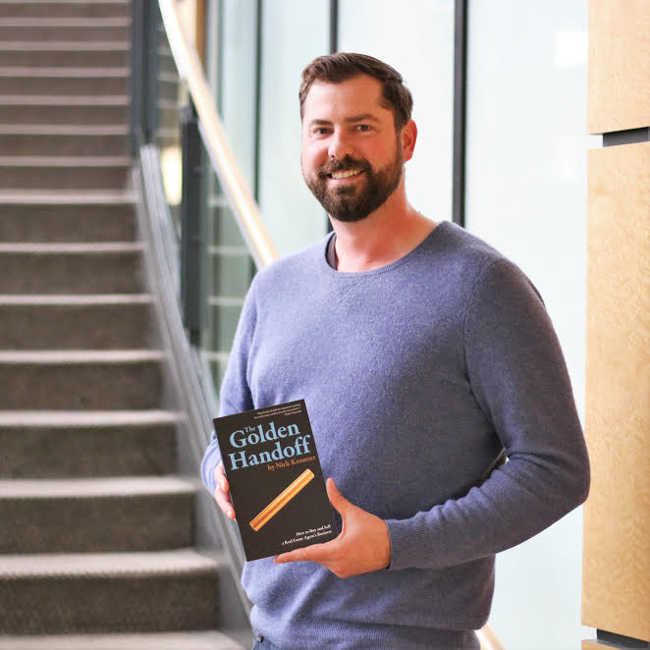
THE GOLDEN HANDOFF
ORDER NOW + EMAIL NICK TO GET FREE RESOURCES!
The Golden Handoff
www.GoldenHandoff.com
503-901-8100
NICK@SELLPDX.COM
GOLDENHANDOFF.COM
Nick Krautter
Principal Broker
City & State
Real Estate
Sell PDX Team
35 NE Weidler St.
Portland, OR 97232
Free Team Whitepaper: Sellpdx.com/Team
Free Market Report: Sellpdx.com/Report

Slide 36
Questions?
ASK IN THE CHAT
OR SEND AN EMAIL TO:
FINANCIALWELLNESS@NAR.REALTOR

Slide 37
Closing Statement
Nick Krautter, CCIM

Slide 38
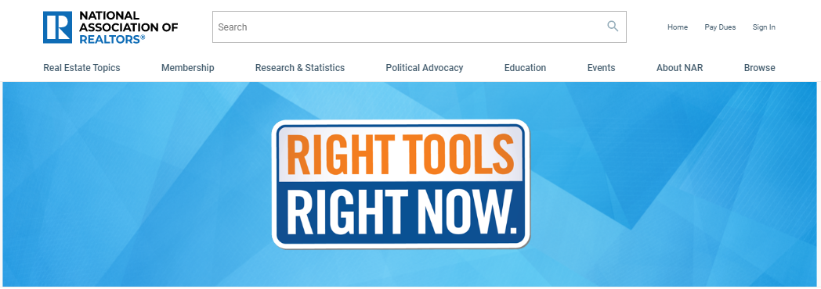
Additional Resources: nar.realtor/RTRN

Slide 39
Thank You For Your Time
Webinar Recording Available:
Friday, June 19th
Visit – nar.realtor/cffw/webinars
FOR MORE INFORMATION or QUESTIONS
EMAIL: FinancialWellness@nar.realtor

Slide 40
1. Visit FinancialWellness.realtor 2. Leave us your feedback. 3. Register for the next webinar. Thanks!

